Slide 1
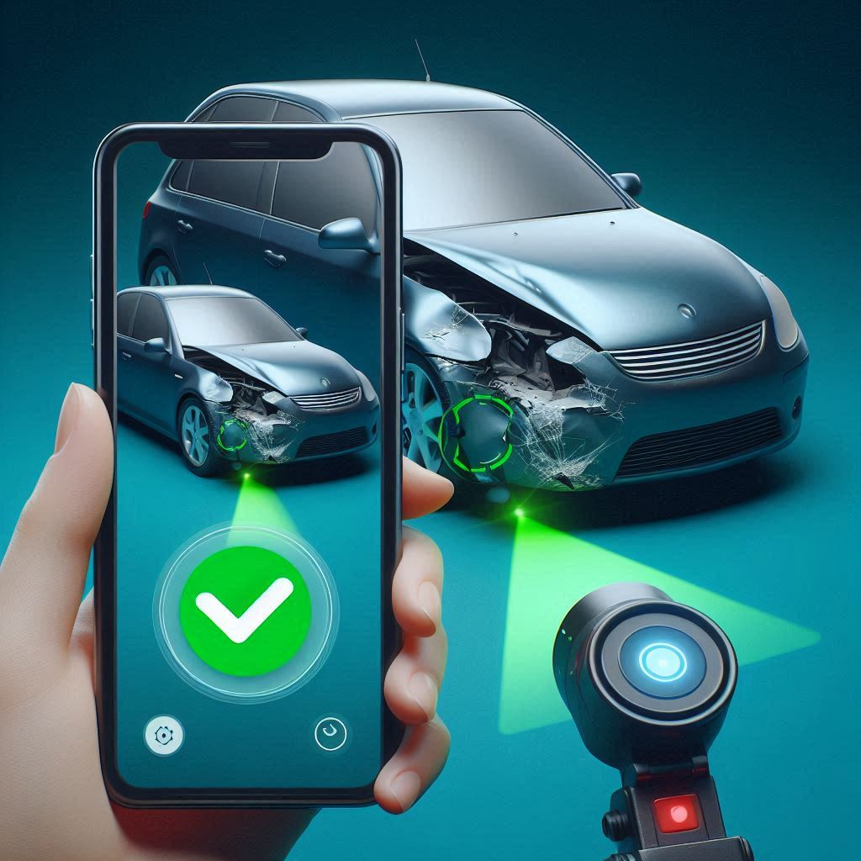
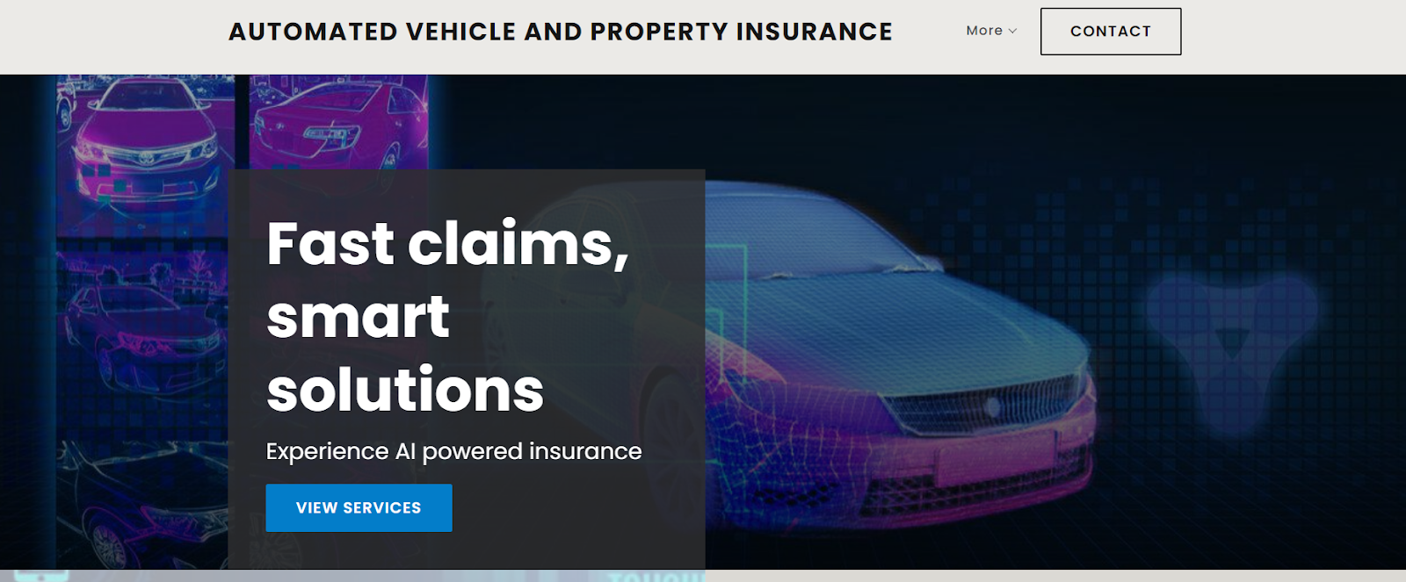


Automated Vehicle and Property Insurance
Fast Claims, Smart Solution

Slide 2
Problem Statement
Traditional damage assessment & claim processing in vehicle & property insurance aren’t just slow they’re also full of labor and make mistakes. This leads to delays & going up.
Because of these issues, claims take longer to resolve. Customers get less satisfaction, while insurance companies face more operational burdens.
There’s a pressing need for an AI-powered solution to make the claims process smoother. We need less manual inspections. Plus, improving accuracy & speed in damage assessments and cost estimations is super important.

Slide 3
Statistics And Stakeholders
Statistics
The global auto insurance market was valued at $788.4 billion in 2021 and is projected to reach $1.02 trillion by 2027, growing at a CAGR of 4.7% from 2022 to 2027.
The AI in the insurance market was valued at $2.74 billion in 2020 and is expected to reach $45.74 billion by 2030, growing at a CAGR of 32.5% from 2021 to 2030.
The average cost of a manual vehicle inspection in the U.S. can range between $150 and $300 per claim, which can add up to significant expenses for insurers handling large volumes of claims
Stakeholders
Insurance companies
Agents and Brokers
Claims Adjusters
Third Service provider
Legal Advisors
Risk Managers
Customer/Property owner
Source : https://www.alliedmarketresearch.com/car-insurance-market-A15156
Source :https://www.iihs.org

Slide 4
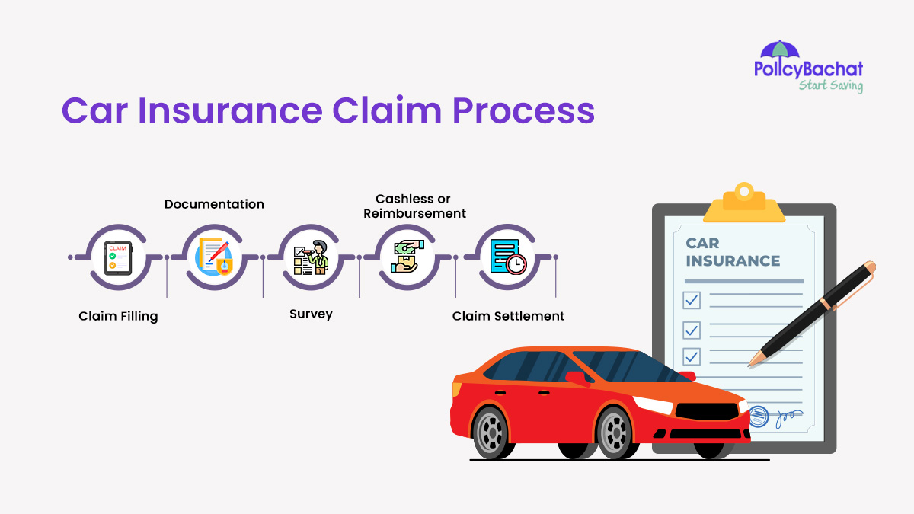
Present Scenario
Competitors
Current Solutions
Tractable
CCC Intelligent Solution
Claim Genius
Mitchell International
1. Digital Claims Processing: Many insurers now offer online platforms and mobile apps that allow customers to file and track claims, speeding up the process and improving transparency.
2. Telematics and IoT Devices: Some insurance companies use technology like GPS and sensors in vehicles or properties to assess damage, monitor usage, and streamline claims processing.
3. AI and Automation: Insurers are increasingly using artificial intelligence and automation to quickly evaluate claims, detect fraud, and offer faster payouts to customers.

Slide 5
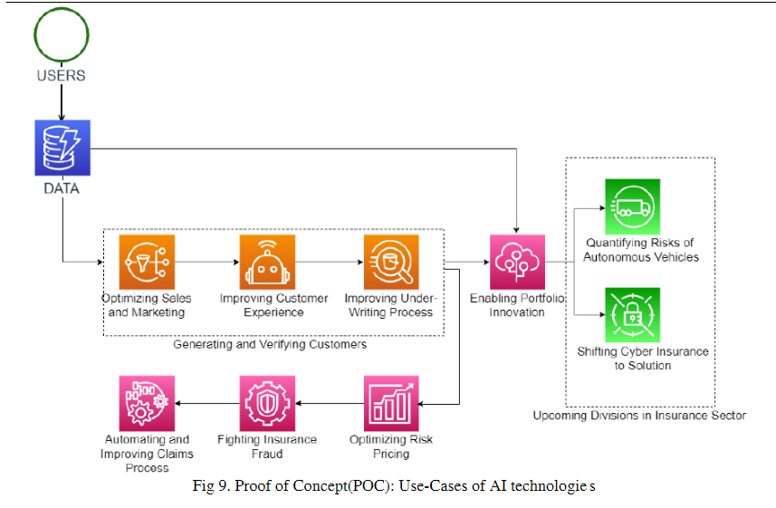
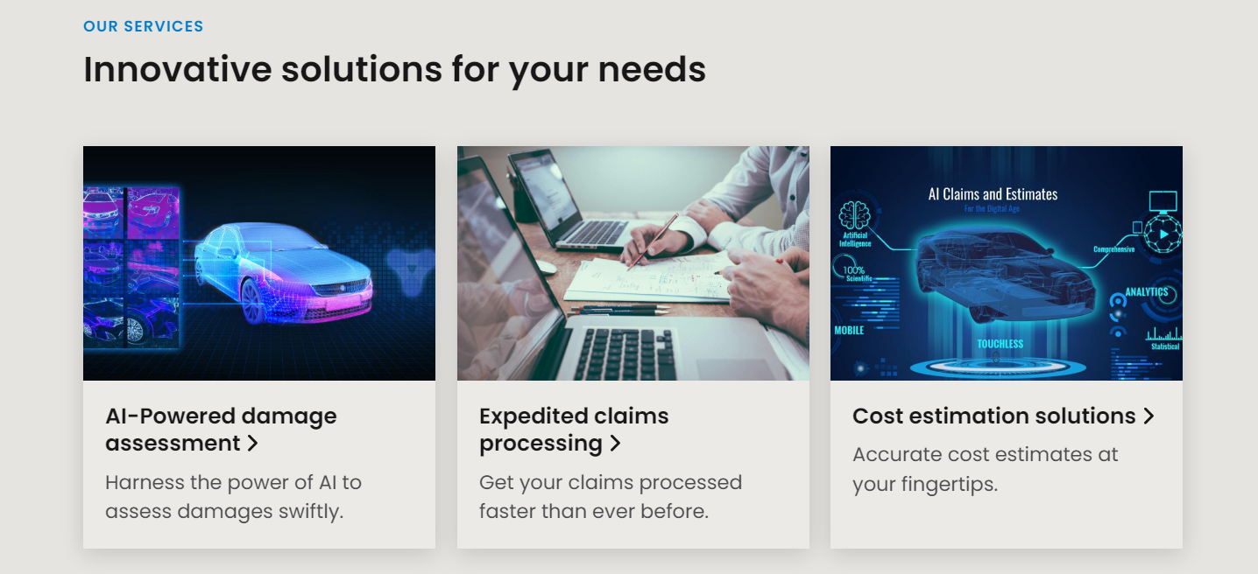
Proposed Solution
Automated Damage Detection:
Using Computer Vision and Machine Learning Algorithm
Cost Estimation
Real-time Processing
Integration with Existing Systems

Slide 6
Features
Using computer vision(Object Detection and Segment Detection) to access the damage
Estimating the Repair Cost and integrating into the Insurance system
Real Time video Camera Inspection if needed.
A chatbot with all car and Insurance required Queries.
Tech Stack
Frontend : HTML, CSS, Javascript,React.js
Python
Computer Vision
Tensorflow
PostgreSQL, MongoDB
Google Cloud and Gemini API

Slide 7
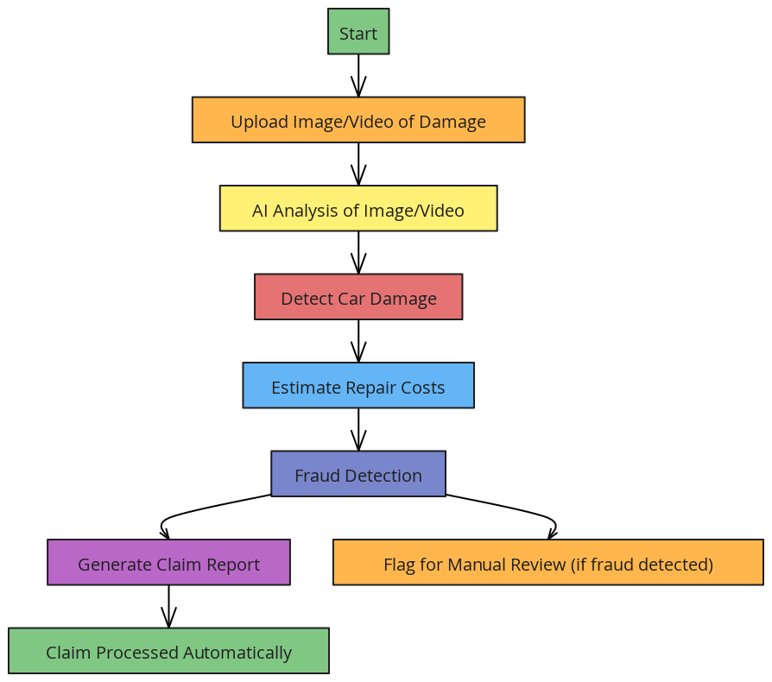
Unique Selling
Using Computer vision and custom Yolo v8 and segment detection for accurate damage detection
Fraud Detection in Insurance through Anomaly detection
Real Time video call
Fast Claims and less Physical Inspection
Interactive Chatbot about Insurance
Prototype:
https://automated-vehicle-and-property-insurance.b12sites.com/index

Slide 8


